Slide 1
Data Pipelines
Series of data processing steps
ETL: Extract, Transform, Load
1. APIs and Requests
2. WebScraping
a) Selenium
b) Requests

Slide 2
Review
What is an API?
What is a Request?
Name at least four commands you can use with request?
What type is a json object in Python?

Slide 3
Hacker Mindset
Don’t learn what you are doing by heart
I am here just to show you the tools that you will use
Each one has a way to build a house
You have to use your toolkit to build your own house
Speaking of houses…

Slide 4
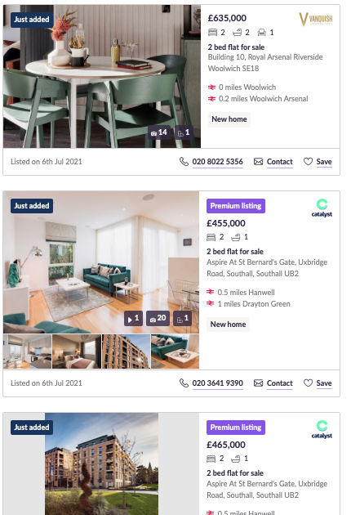
Your task
By the end of the week, you will be able to scrape data from a housing website (Zoopla)
To do so, we have two main tools: Selenium, and Requests; and another library that will help us visualize the HTML code: Beautiful Soup
But first, what is HTML?

Slide 5




HTML
We already know what a request is, let’s see the its workflow.
Thor’s computer sends along a stream of 1 and 0 bits
These bits form some information, containing a header and body
Loki’s server locates the correct HTML file
Header:
MAC address and IP address
Body:
This is a GET request
I want to see hammers.html
10101010101010101011
10101010101011101010
10110101011101010101
00010100100101011010
IP address… ✅
Request… ✅
Computer
Server
Thor
Loki

Slide 6
HTML
We already know what a request is, let’s see the its workflow.
And send back the information to Thor’s computer
10101010101010101011
10101010101011101010
10110101011101010101
00010100100101011010
Header:
Request Status
Body:
Hammers HTML
Computer
Server
Thor
Loki

Slide 7
HTML
We already know what a request is, let’s see the its workflow.
Computer
Thor

Slide 8
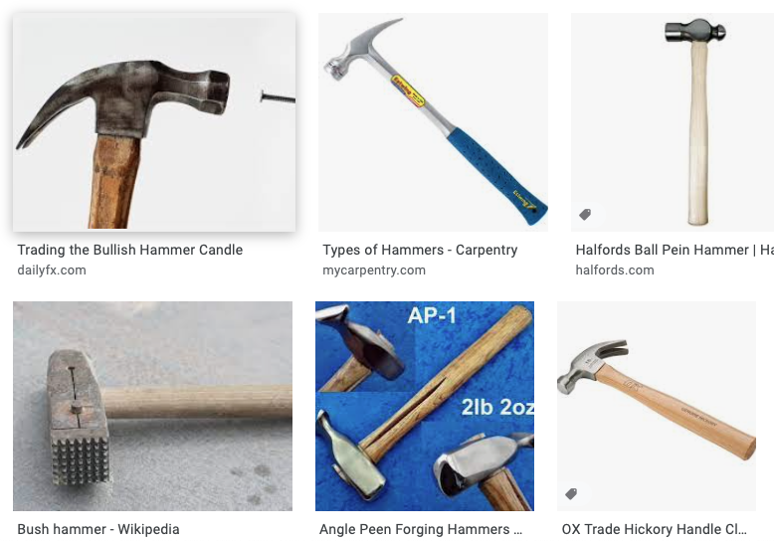
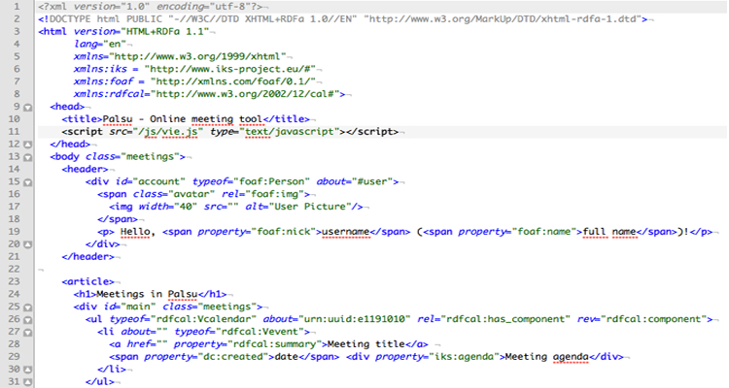
HTML
We already know what a request is, let’s see the its workflow.

Slide 9
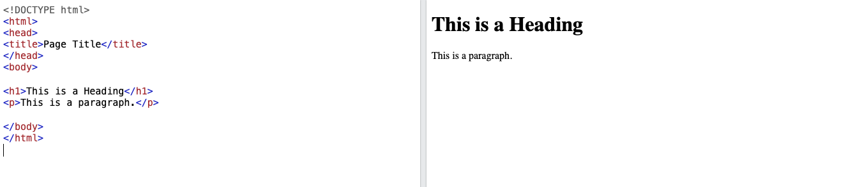
HTML
HTML is the standard markup language for Web pages
HTML describes the structure of a Web page
HTML elements tell the browser how to display the content
HTML elements label pieces of content known as tags: <p> <h1> <body> <span>
https://www.w3schools.com/html/tryit.asp?filename=tryhtml_default

Slide 10
HTML
HTML tags have also attributes, such as class, id, href…
Let’s see an example in:
http://www.pythonscraping.com/pages/warandpeace.html
Observe the HTML code (Right Click and View Page Source or Inspect)

Slide 11
HTML
Let’s see another example to see the structure of a HTML page
http://pythonscraping.com/pages/page3.html
- We can leverage the tags and the attributes to access to specific items
- Let’s use request to get the elements in Fish Painting
- We will also use another tool named Beautiful Soup, which will help us
navigating through the HTML code
- If you don’t have it, in the terminal type pip install beautifulsoup4

Slide 12
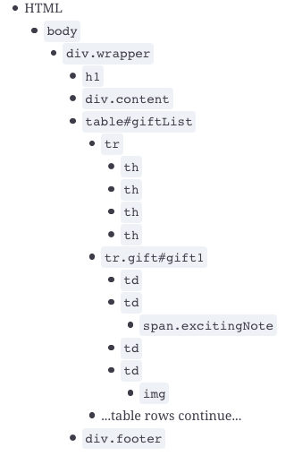
Beautiful Soup
BS is a library for pulling data out of HTML files. It allows you to:
Find tags with specific characteristics
Find all tags that contain certain characteristics
Find the siblings, parents and children of these tags
Retrieve the data contained in these tags (text, href, image)

Slide 13
Beautiful Soup
import requests
import bs4
page = requests.get('http://pythonscraping.com/pages/page3.html')
html = page.text
soup = bs4.BeautifulSoup(html, 'html.parser')
print(soup)
"html.parser", makes sure that you use the appropriate parser for HTML content.

Slide 14
Challenge
What is a Python Method?
Get the HTML code of the next page using requests: https://en.wikipedia.org/wiki/Python_(programming_language)
Inspect the page in your browser and look for Methods
Identify the tag with its corresponding id. In this case identify the span tag whose id is ‘Methods’ corresponding to the Methods section. Then find its parent which is an <h3> tag. From the <h3> tag, find its Next sibling, corresponding to a <p> tag
Get the text and store it in a variable called method_definition

Slide 15

Good job!
Now, you are able to use requests and beautiful soup to extract data from any webpage…

Slide 16
Selenium
We know how to access elements in a HTML code but, what if…
We need to accept cookies 🍪?
We need to use the search bar 🔍?
We need to click on a button, such as Next ⏭️ ?
We need to scroll down for the page to load ⏬?
We need to wait for the whole page to load (Emoji not found)?

Slide 17
Selenium
Selenium WebDriver is a web framework that permits you to execute cross-browser tests. This tool is used for automating web-based application testing to verify that it performs expectedly.

Slide 18
Selenium - Setup
Install selenium: pip install selenium
Install the web driver: Chrome, Firefox… https://www.selenium.dev/downloads/
Chrome
Check your chrome version
Go to the next page: https://sites.google.com/a/chromium.org/chromedriver/
Download the corresponding version
Firefox:
Go to the next page: https://github.com/mozilla/geckodriver/releases
Download the version for your OS
Have fun!

Slide 19
Selenium
One advantage over Beautiful Soup, you can use Xpaths:
XPath uses path expressions to select nodes or node-sets in an XML or HTML document. (Check differences of both languages here)
2) Has commands that a human would do:
.send_keys(): Send something as if you were writing
.execute_script(): Execute a command such as scroll
.back(): Go to the last visited page
.click(): left-click of your hand-held pointing device that detects two-dimensional motion relative to a surface
Just think what you want to do, and google it!

Slide 20
Example
What is a Python Method? Round 2
Use the driver to go to the following page: “http://www.python.org"
Look for the search bar
Clear it and type method
Get all the links available
Go to each link and extract the first paragraph of the introduction

Slide 21
Takeaways
Think of the common things and look for a pattern
Exploit that pattern, the more you work on your code now the less you will work
Be careful with going too fast (time.sleep)
Xpath are useful, but use them carefully

Slide 22
Your task
By the end of the week, you will be able to scrape data from a housing website (Zoopla)
To do so, we have two main tools: Selenium, and Requests; and another library that will help us visualize the HTML code: Beautiful Soup
But first, what is HTML?

Slide 23
Zoopla Challenge
By the end of the week, you will be able to scrape data from a housing website (Zoopla)
To do so, we have two main tools: Selenium, and Requests; and another library that will help us visualize the HTML code: Beautiful Soup
But first, what is HTML?

